Slide 1
Major Md. Ferdausur Rahman, PhD
Associate Professor
Dept. of Sc & Hum, Military Institute of Science and Technology (MIST),
Mirpur Cantonment, Dhaka-1216, Bangladesh.
Mobile :0088 01769024146
E-mail : ferdaus806@gmail.com
majorferdausmist@gmail.com

Slide 2

ACCOUNTING IN ACTION
Learning Objectives
After studying this chapter, you should be able to:
[1] Explain the history and meaning of accounting.
[2] Identify the users and uses of accounting.
[3] Understand why ethics is a fundamental business concept.
[4] Explain generally accepted accounting principles.
[5] Explain the monetary unit assumption and the economic entity assumption.
[6] State the accounting equation, and define its components.
[7] Analyze the effects of business transactions on the accounting equation.
[8] Understand the four financial statements and how they are prepared.
[9] Solve The Problem: P1-1B, P1-2B

Slide 3
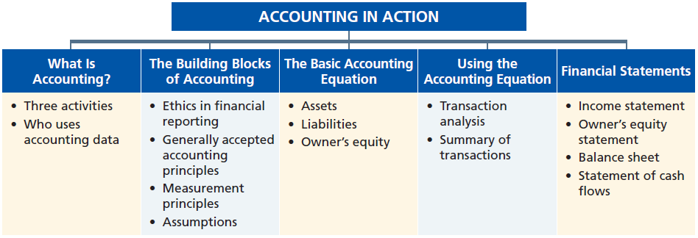
PREVIEW OF CHAPTER

Slide 4
HISTORY AND MEANINGOF ACCOUNTING
Accounting is very old and most important subject. The word “ACCOUNT” has come from the Latin words “ad” + “computere” which means to reckon together. The word “reckon” means to count up, compute or calculate.
The word ACCOUNTANT has come from the older English word accomptant. This word come from the French word compter which comes from the Latin word computare – to reckon, count, number
LO 1 Explain what accounting is.

Slide 5
HISTORY AND MEANINGOF ACCOUNTING
He said, “O Adam, tell them their
names.” And when he told them their
names, He said, “Did I not tell you
that I know the secrets of the
heavens and the earth, and that I
know what you reveal and what you
conceal?”
---- Al Quran-02:33

Slide 6
HISTORY AND MEANINGOF ACCOUNTING
So it can be easily said that It is also the most important part of life for each and everybody. From beggar to king, from poor to rich, from illiterate to higher educated, nobody can avoid it. On the other hand, accounting is directly related with financial or economic events (earnings & expenses). So we cannot pass a single moment without accounting. Say I am conducting a class here and using board, marker, electricity, furniture, etc. Everything has some cost or financial value. So many financial events are happening in this class room.

Slide 7
HISTORY AND MEANINGOF ACCOUNTING
In 1494, the first book on double-entry accounting was published by Luca Pacioli as the "Father of Accounting," . The first accounting book actually was one of five sections in Pacioli's mathematics book titled
SUMMA DE ARITHMETICA, GEOMETRIA, PROPORTIONI ET PROPORTIONALITA
(Everything About Arithmetic, Geometry and Proportions)

Slide 8
WHAT IS ACCOUNTING?
Accounting is an information system that identifies, records and communicates the economic events of an organization to interested users.
Purpose of accounting is to:
  identify,
  record, and
  communicate
  the economic events of an organization to interested users.
LO 1 Explain what accounting is.

Slide 9
HISTORY AND MEANINGOF ACCOUNTING
O you who believe! When you
incur debt among yourselves for a
certain period of time, write it down.
And have a scribe write in your
presence, in all fairness. And let no
scribe refuse to write, as ALLAH has
taught him. So let him write, and let
the debtor dictate. And let him fear
ALLAH, his Lord, and diminish nothing
from it.
---- Al Quran-02:282

Slide 10
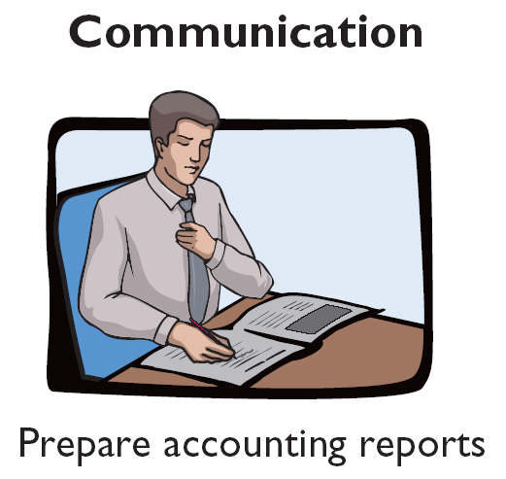
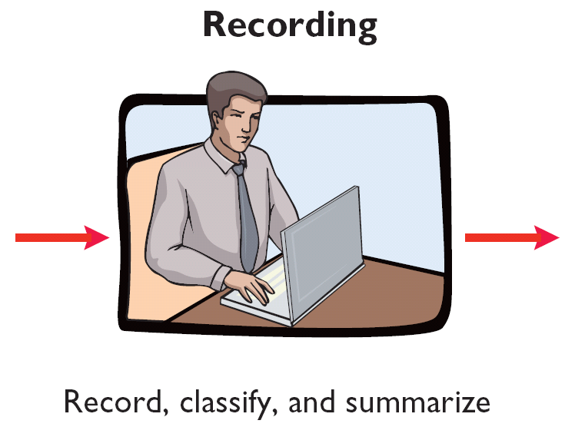
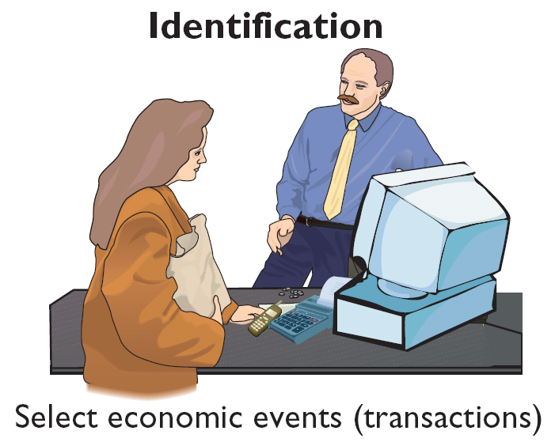
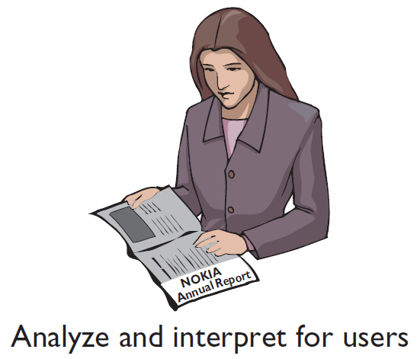
WHAT IS ACCOUNTING?
Three Activities
Illustration 1-1
Accounting process
The accounting process includes
the bookkeeping function.
LO 1 Explain what accounting is.

Slide 11
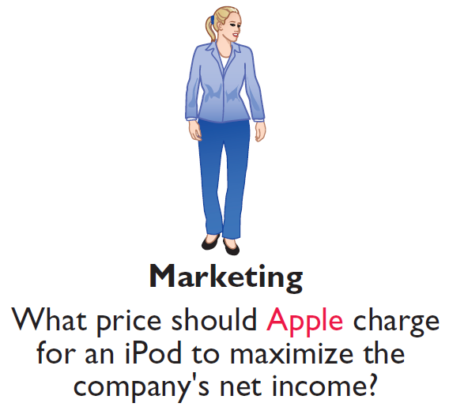
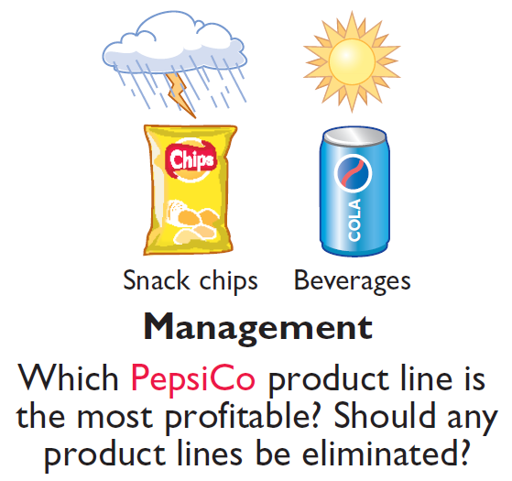
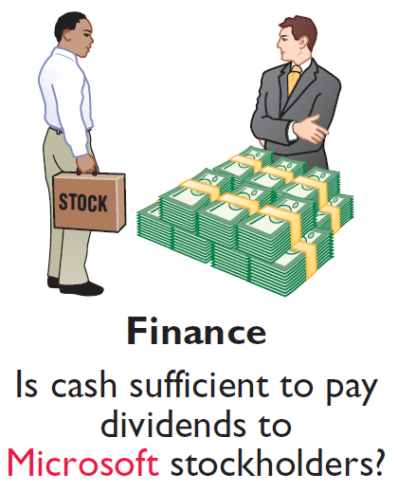

WHO USES ACCOUNTING DATA
Internal Users
Illustration 1-2
Questions that internal users ask
LO 2

Slide 12
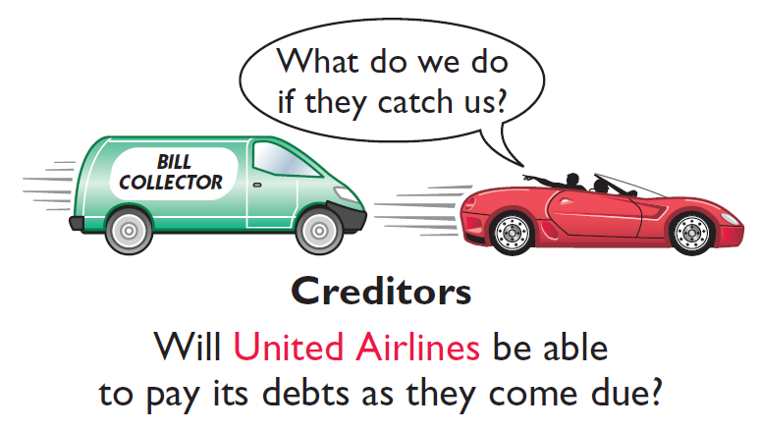
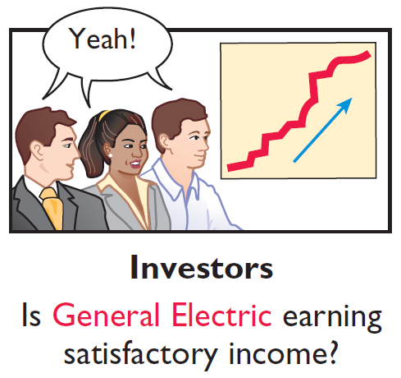
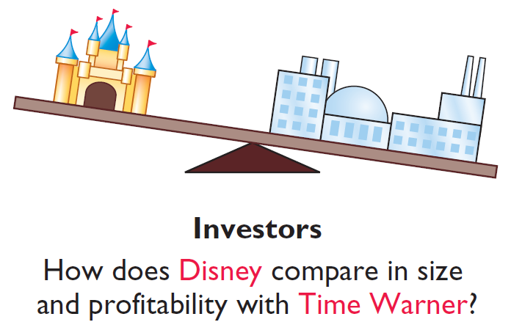
WHO USES ACCOUNTING DATA
External Users
Illustration 1-3
Questions that external users ask
LO 2

Slide 13
THE BUILDING BLOCKS OF ACCOUNTING
Ethics In Financial Reporting
United States regulators and lawmakers were very concerned that the economy would suffer if investors lost confidence in corporate accounting because of unethical financial reporting.
  Recent financial scandals include: Enron, WorldCom, HealthSouth, and others.
  Congress passed Sarbanes-Oxley Act of (SOX) 2002.
  Effective financial reporting depends on sound ethical behavior.
LO 3 Understand why ethics is a fundamental business concept.

Slide 14
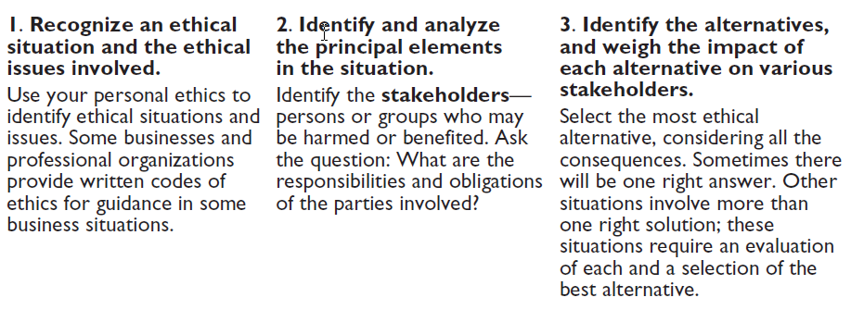
THE BUILDING BLOCKS OF ACCOUNTING
Ethics In Financial Reporting
Illustration 1-4
Steps in analyzing ethics cases and situations
LO 3 Understand why ethics is a fundamental business concept.

Slide 15
ENGINEERING ACCOUNTING
Engineering Accounting is a subset of Project accounting. The target of Engineering Accounting is to properly track and report the use of resources in relation to engineering projects. It differs from Construction Accounting due to the basis of the inputs and the goals of the reporting. Engineering Accounting combines management reporting and financial reporting for engineering based projects.
Engineering Accounting is a field that identifies project scope then measures and communicates costs of a projects outcomes

Slide 16
ETHICS IN FINANCIAL REPORTING
Question
Ethics are the standards of conduct by which one's actions are judged as:
  right or wrong.
  honest or dishonest.
  fair or not fair.
  all of these options.
LO 3 Understand why ethics is a fundamental business concept.

Slide 17

GENERALLY ACCEPTED ACCOUNTING PRINCIPLES
Financial Statements
Balance Sheet
Income Statement
Statement of Owner’s Equity
Statement of Cash Flows
Note Disclosure
Various users need financial information
The accounting profession has attempted to develop a set of standards that are generally accepted and universally practiced.
Generally Accepted Accounting Principles (GAAP)
LO 4 Explain generally accepted accounting principles.

Slide 18
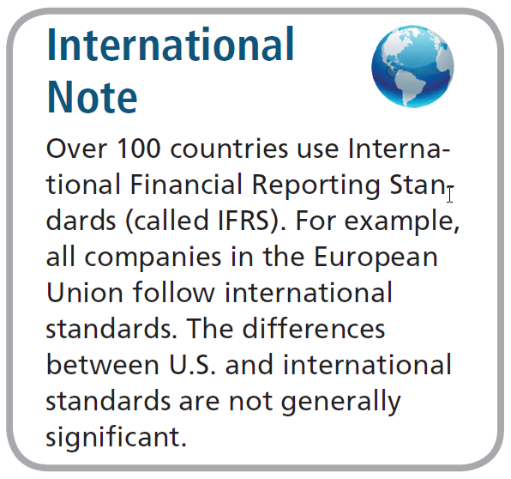
GENERALLY ACCEPTED ACCOUNTING PRINCIPLES
Generally Accepted Accounting Principles (GAAP) - A set of rules and practices, having substantial authoritative support, that the accounting profession recognizes as a general guide for financial reporting purposes.
Standard-setting bodies:
  Securities and Exchange Commission (SEC)
  Financial Accounting Standards Board (FASB)
  International Accounting Standards Board (IASB)
LO 4 Explain generally accepted accounting principles.

Slide 19
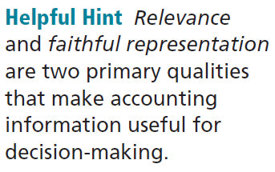
GENERALLY ACCEPTED ACCOUNTING PRINCIPLES
Measurement Principles
Historical Cost Principle (or cost principle) dictates that companies record assets at their cost.
Fair Value Principle states that assets and liabilities should be reported at fair value (the price received to sell an asset or settle a liability).
Selection of which principle to follow generally relates to trade-offs between relevance and faithful representation.
LO 4 Explain generally accepted accounting principles.

Slide 20
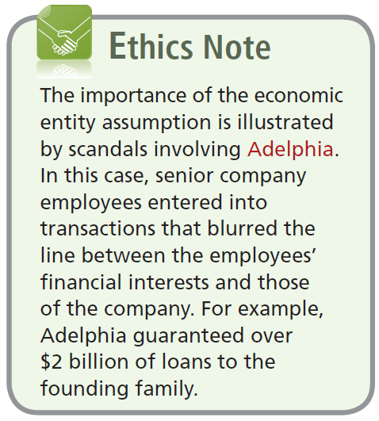
GENERALLY ACCEPTED ACCOUNTING PRINCIPLES
Assumptions
Monetary Unit Assumption requires that companies include in the accounting records only transaction data that can be expressed in terms of money.
Economic Entity Assumption requires that activities of the entity be kept separate and distinct from the activities of its owner and all other economic entities.
LO 5 Explain the monetary unit assumption and the economic entity assumption.

Slide 21
FORMS OF BUSINESS OWNERSHIP
Proprietorship
Partnership
Corporation
Generally owned by one person.
Often small service-type businesses
Owner receives any profits, suffers any losses, and is personally liable for all debts.
Owned by two or more persons.
Often retail and service-type businesses
Generally unlimited personal liability
Partnership agreement
Ownership divided into shares of stock
Separate legal entity organized under state corporation law
Limited liability
LO 5 Explain the monetary unit assumption and the economic entity assumption.
Notes:
Service Cost - Actuaries compute service cost as the present value of the new benefits earned by employees during the year. Future salary levels considered in calculation.
Interest on Liability - Interest accrues each year on the PBO just as it does on any discounted debt.
Actual Return on Plan Assets - Increase in pension funds from interest, dividends, and realized and unrealized changes in the fair market value of the plan assets.
Amortization of Unrecognized Prior Service Cost - The cost of providing retroactive benefits is allocated to pension expense in the future, specifically to the remaining service-years of the affected employees.
Gain or Loss - Volatility in pension expense can be caused by sudden and large changes in the market value of plan assets and by changes in the projected benefit obligation. Two items comprise the gain or loss:
difference between the actual return and the expected return on plan assets and,
amortization of the unrecognized net gain or loss from previous periods

Slide 22
GENERALLY ACCEPTED ACCOUNTING PRINCIPLES
Question
Combining the activities of Kellogg and General Mills would violate the
  cost principle.
  economic entity assumption.
  monetary unit assumption.
  ethics principle.
LO 5 Explain the monetary unit assumption and the economic entity assumption.

Slide 23
GENERALLY ACCEPTED ACCOUNTING PRINCIPLES
Question
A business organized as a separate legal entity under state law having ownership divided into shares of stock is a
  proprietorship.
  partnership.
  corporation.
  sole proprietorship.
LO 5 Explain the monetary unit assumption and the economic entity assumption.

Slide 24
THE BASIC ACCOUNTING EQUATION
Assets
Liabilities
Owner’s Equity
=
+
Accounting Equation is the mathematical expression of total accounting system.
Provides the underlying framework for recording and summarizing economic events.
Assets are claimed by either creditors or owners.
Claims of creditors must be paid before ownership claims.
State the accounting equation, and define its components.

Slide 25
THE BASIC ACCOUNTING EQUATION
Assets
  Resources a business owns.
  Provide future services or benefits.
  Cash, Supplies, Equipment, etc.
Assets
Liabilities
Owner’s Equity
=
+
LO 6 State the accounting equation, and define its components.

Slide 26
THE BASIC ACCOUNTING EQUATION
Liabilities
  Claims against assets (debts and obligations).
  Creditors - party to whom money is owed.
  Accounts payable, Notes payable, etc.
Assets
Liabilities
Owner’s Equity
=
+
LO 6 State the accounting equation, and define its components.

Slide 27
THE BASIC ACCOUNTING EQUATION
Owner’s Equity
  Ownership claim on total assets.
  Referred to as residual(remaining) equity.
  Investment by owners and revenues (+)
  Drawings and expenses (-).
Assets
Liabilities
Owner’s Equity
=
+
LO 6 State the accounting equation, and define its components.

Slide 28
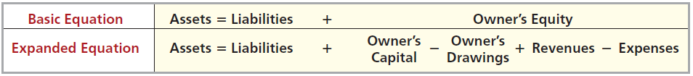
OWNER’S EQUITY
Illustration 1-6
Increases in Owner’s Equity
Investments by owner are the assets the owner puts into the business.
Revenues result from business activities entered into for the purpose of earning income.
  Common sources of revenue are: sales, fees, services, commissions, interest, dividends, royalties, and rent.
LO 6 State the accounting equation, and define its components.

Slide 29
OWNER’S EQUITY
Illustration 1-6
Decreases in Owner’s Equity
Drawings An owner may withdraw cash or other assets for personal use.
Expenses are the cost of assets consumed or services used in the process of earning revenue.
  Common expenses are: salaries expense, rent expense, utilities expense, tax expense, etc.
LO 6 State the accounting equation, and define its components.

Slide 30
USING THE ACCOUNTING EQUATION
Transactions are a business’s economic events recorded by accountants.
  May be external or internal.
  Not all activities represent transactions.
  Each transaction has a dual effect on the accounting equation.
LO 7 Analyze the effects of business transactions on the accounting equation.

Slide 31


USING THE ACCOUNTING EQUATION
Illustration: Are the following events recorded in the accounting records?
Discuss guided trip options with customer
Purchase computer
Event
Pay rent
Criterion
Is the financial position (assets, liabilities, or owner’s equity) of the company changed?
Record/ Don’t Record
LO 7 Analyze the effects of business transactions on the accounting equation.

Slide 32
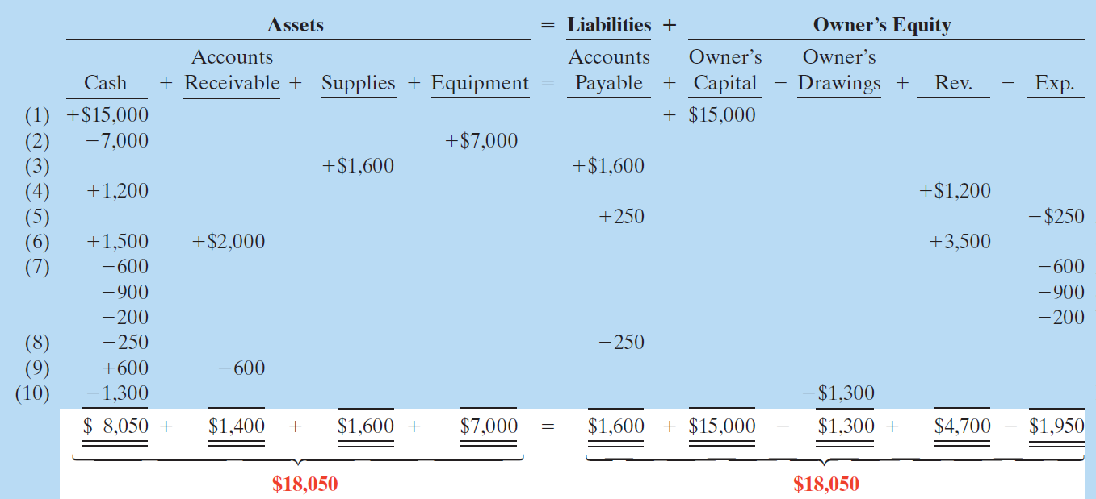
TRANSACTION ANALYSIS
Transaction (1): Ray Neal decides to open a computer programming service which he names Softbyte. On September 1, 2014, Ray Neal invests $15,000 cash in the business.
LO 7

Slide 33
TRANSACTION ANALYSIS
Transaction (2): Purchase of Equipment for Cash. Softbyte purchases computer equipment for $7,000 cash.
LO 7

Slide 34
TRANSACTION ANALYSIS
Transaction (3): Softbyte purchases for $1,600 from Acme Supply Company computer paper and other supplies expected to last several months. The purchase is made on account.
LO 7

Slide 35
TRANSACTION ANALYSIS
Transaction (4): Softbyte receives $1,200 cash from customers for programming services it has provided.
LO 7

Slide 36
TRANSACTION ANALYSIS
Transaction (5): Softbyte receives a bill for $250 from the Daily News for advertising but postpones payment until a later date.
LO 7

Slide 37
Transaction Analysis
Transaction (6): Softbyte provides $3,500 of programming services for customers. The company receives cash of $1,500 from customers, and it bills the balance of $2,000 on account.
LO 7

Slide 38
TRANSACTION ANALYSIS
Transaction (7): Softbyte pays the following expenses in cash for September: store rent $600, salaries of employees $900, and utilities $200.
LO 7

Slide 39
TRANSACTION ANALYSIS
Transaction (8): Softbyte pays its $250 Daily News bill in cash.
LO 7

Slide 40
TRANSACTION ANALYSIS
Transaction (9): Softbyte receives $600 in cash from customers who had been billed for services [in Transaction (6)].
LO 7

Slide 41
TRANSACTION ANALYSIS
Transaction (10): Ray Neal withdraws $1,300 in cash from the business for his personal use.
Illustration 1-8
Tabular summary of
Softbyte transactions
LO 7

Slide 42
FINANCIAL STATEMENTS
Companies prepare four financial statements :
Income Statement
Owner’s Equity Statement
Balance Sheet
Statement of Cash Flows
LO 8 Understand the four financial statements and how they are prepared.

Slide 43
FINANCIAL STATEMENTS
Question
Net income will result during a time period when:
  assets exceed liabilities.
  assets exceed revenues.
  expenses exceed revenues.
  revenues exceed expenses.
LO 8 Understand the four financial statements and how they are prepared.

Slide 44
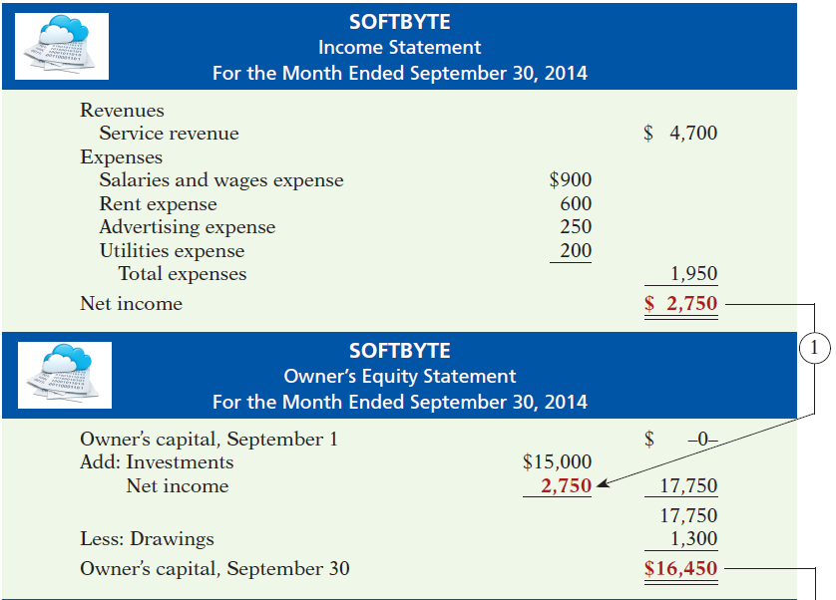
Net income is needed to determine the ending balance in owner’s equity.
FINANCIAL STATEMENTS
Illustration 1-9
Financial statements and
their interrelationships
LO 8

Slide 45
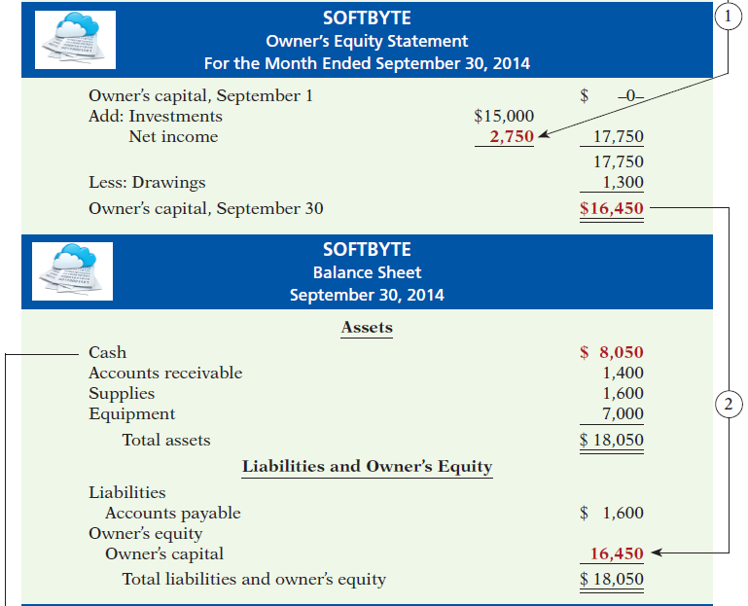
The ending balance in owner’s equity is needed in preparing the balance sheet
FINANCIAL STATEMENTS
Illustration 1-9
LO 8

Slide 46
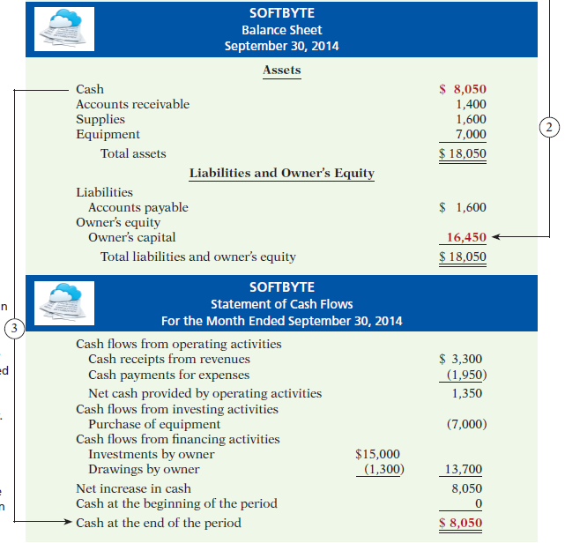
The balance sheet and income statement are needed to prepare statement of cash flows.
FINANCIAL STATEMENTS
Illustration 1-9
LO 8

Slide 47
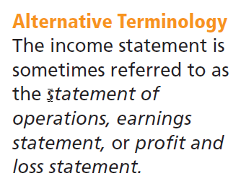
FINANCIAL STATEMENTS
Income Statement
Reports the revenues and expenses for a specific period of time.
Lists revenues first, followed by expenses.
Shows net income (or net loss).
LO 8 Understand the four financial statements and how they are prepared.

Slide 48
FINANCIAL STATEMENTS
Owner’s Equity Statement
Reports the changes in owner’s equity for a specific period of time.
The time period is the same as that covered by the income statement.
LO 8 Understand the four financial statements and how they are prepared.

Slide 49
FINANCIAL STATEMENTS
Balance Sheet
Reports the assets, liabilities, and owner’s equity at a specific date.
Lists assets at the top, followed by liabilities and owner’s equity.
Total assets must equal total liabilities and owner’s equity.
Is a snapshot of the company’s financial condition at a specific moment in time (usually the month-end or year-end).
LO 8 Understand the four financial statements and how they are prepared.

Slide 50
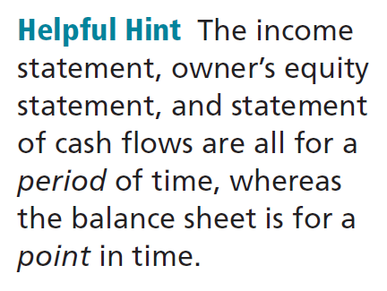
FINANCIAL STATEMENTS
Statement of Cash Flows
Information for a specific period of time.
Answers the following:
  Where did cash come from?
  What was cash used for?
  What was the change in the cash balance?
LO 8 Understand the four financial statements and how they are prepared.

Slide 51
FINANCIAL STATEMENTS
Question
Which of the following financial statements is prepared as of a specific date?
  Balance sheet.
  Income statement.
  Owner's equity statement.
  Statement of cash flows.
LO 8 Understand the four financial statements and how they are prepared.

Slide 52
Home Work: (for all Exams)
P1-1A, P1-2A and P1- 4A
Page No: 42 & 43

Slide 53
QUESTION

Slide 54
THANK YOU SO MUCH
MAY ALMIGHTY ALLAH SAVE ALL OF US

